Slide 1
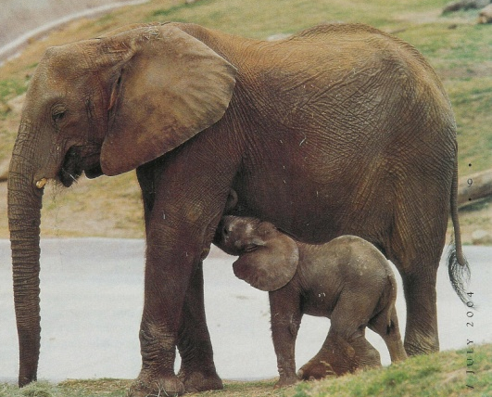
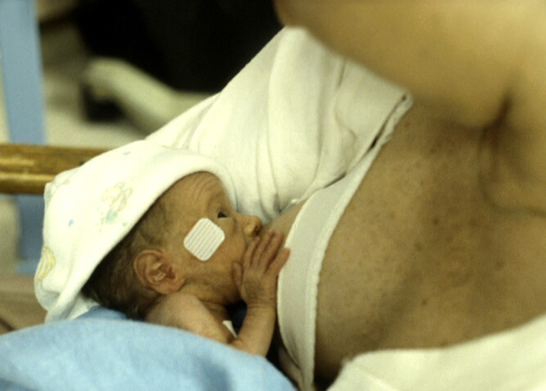
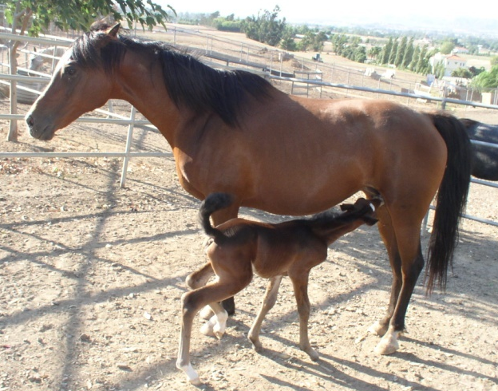
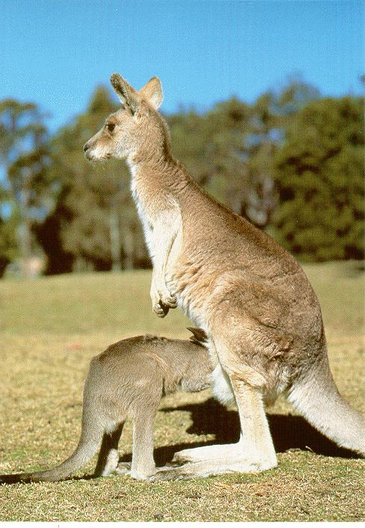

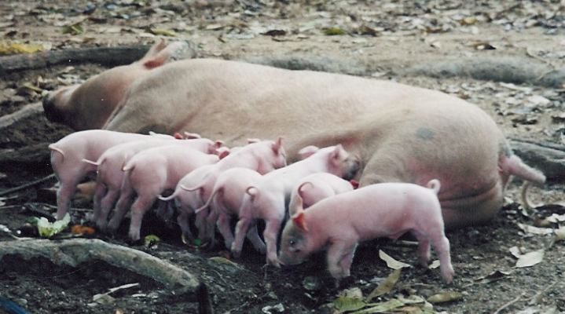

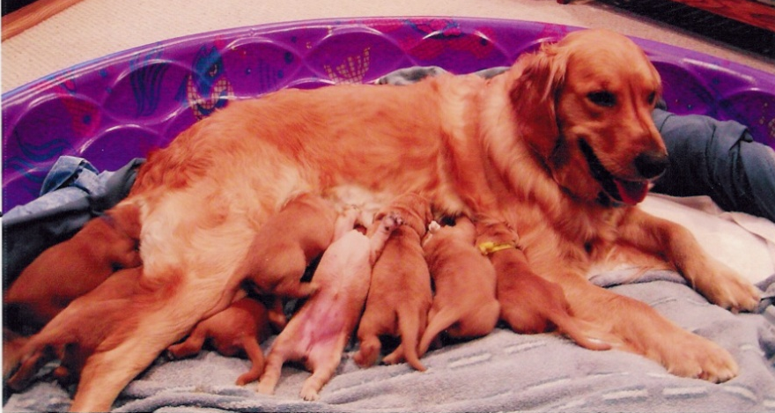
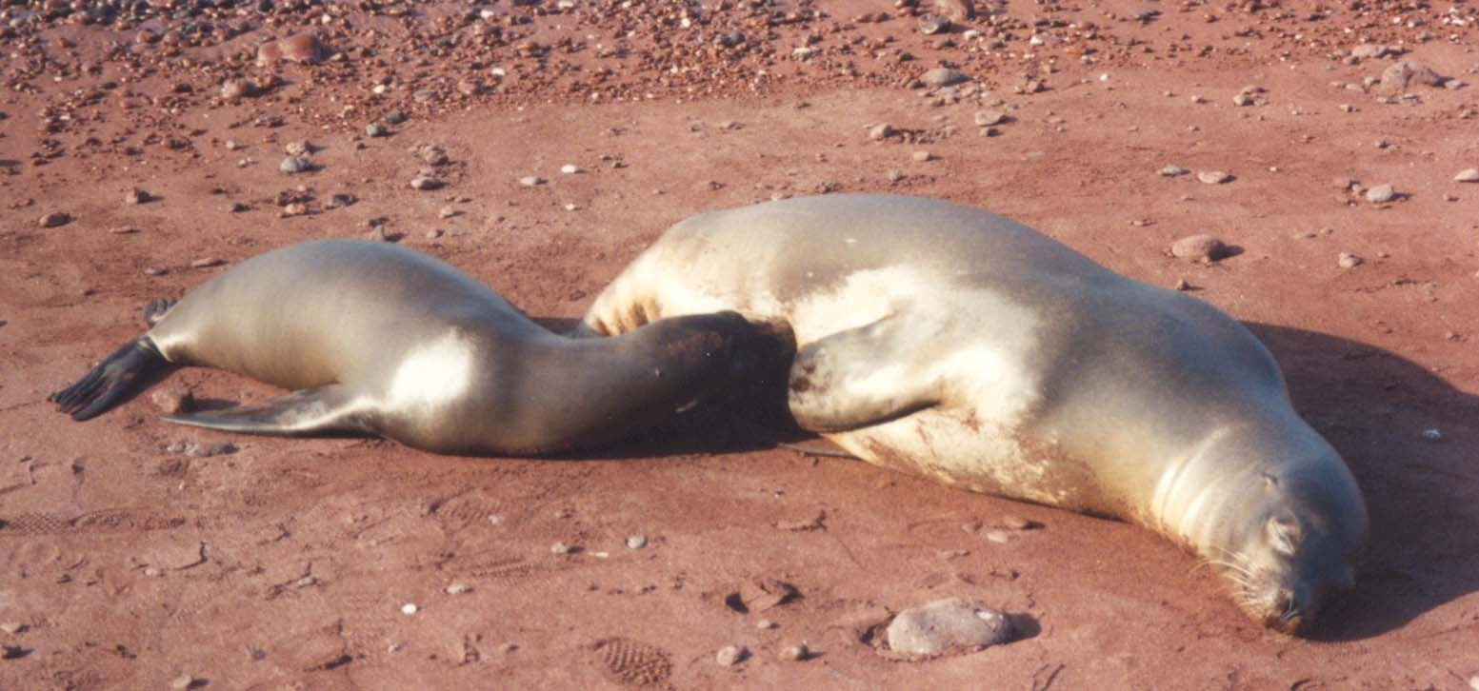

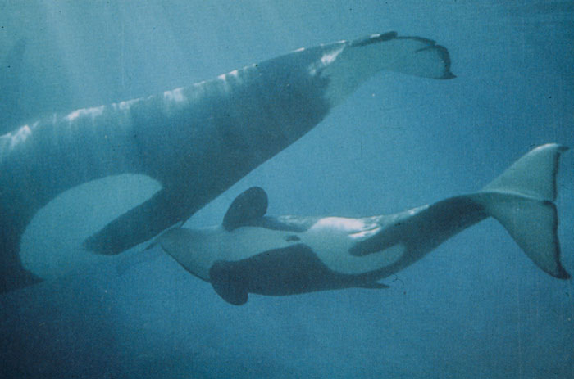
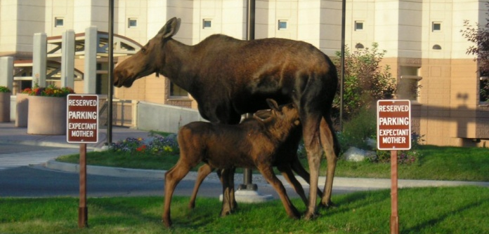
There is a reason behind everything in nature
Aristotle (384-322 BC))

Slide 2



Lactation Supportive Environments
The business case for breastfeeding
(Insert Presenter Name)
(Insert Company Name)

Slide 3

Lactation Supportive Environments
Provide services for obesity prevention through lactation promotion by increasing access to environments that support breastfeeding
Our goals
  Work with local school districts, schools, businesses and community healthcare clinics
  Provide guidance and support through assessment, policy/procedure implementation, technical assistance and resources

Slide 4




Who Benefits From Lactation Accommodation?
Businesses & Schools
Public Health
Our World

Slide 5
How Lactation Accommodation Benefits .. Public Health
Mothers/Employees
Infants/Dependents
Lower risk of some cancers, including breast and ovarian
Lower risk of diabetes
Lower risk of osteoporosis
Lower rates of postpartum depression
First line of defense against obesity
Lower risk of infections and illnesses
  Ear infections
  Respiratory infections
  Dermatitis
  Gastrointestinal disorders

Slide 6



Lactation Benefits:
Babies today …
Your students tomorrow …
Your future employees!

Slide 7
How Lactation Accommodation Benefits … Public Health
“Breastfeeding is a very important economic and public health issue.” –Dr. Melissa Bartick, Harvard Medical School
For every 1,000 babies not breastfed, there is an excess of 2,033 physician visits, 212 days in the hospital, and 609 prescriptions.
The United States would save $13 billion per year and prevent an excess 911 deaths - nearly all of which would be in infants - if 90% of families would comply with medical recommendations.

Slide 8



Lactation Accommodation in the Workplace
Did you know …
  Mothers are one of the fastest growing segments of the workplace?
  In 2012, 57% of all mothers with infants were employed?

Slide 9
How Lactation Accommodation Benefits … Your Workplace
Decrease employee absenteeism?
  Absenteeism is 3 times higher for mothers of formula-fed infants compared to moms of breastfed infants
Increase employee loyalty, retention, productivity as well as recruitment of top quality employees?
  91% of the “100 Best Companies for Working Women” support breastfeeding in the workplace
Reduce health care costs?
  Companies that adopt breastfeeding support programs see a cost savings of $3 for every $1 invested in the program
  Insurers pay at least $3.6 billion each year to treat disease and conditions preventable by breastfeeding

Slide 10

How Lactation Accommodation Benefits … Our World
The manufacturing of packaging for artificial baby milk creates toxins and uses paper, plastic and tin
Each cow used to produce baby formula needs 10,000 square meters of land, which leads to deforestation and soil erosion
The production of artificial baby milk, baby bottles, nipples and other bottle feeding accessories require a great amount of energy worldwide
Lactation is
GREEN

Slide 11

Lactation Accommodation and the Law
Have you heard …
Lactation accommodation in the workplace is the federal and state law?
Compliance is not difficult!

Slide 12
The Basic Needs of Breastfeeding Employees are Minimal
Time and space to express (pump) milk regularly
Information on how to successfully combine employment and breastfeeding
Access to resources that address breastfeeding questions and concerns
Support from supervisors and colleagues
Policy!

Slide 13






A Model for Success
Education & Resources

Slide 14
Breastfeeding Friendly Workplace Award Winners in San Diego County
2014: Southwest Regional Maintenance Center & Vista Community Clinic
2013: Union Bank, San Diego HHSA, YMCA Childcare Resource Center, USD
2012: Intuit, Inc, 2-1-1 San Diego, Clinicas de Salud del Pueblo WIC, San Diego Unified School District
2011: Watkins Manufacturing, Southwest Fisheries Science Center, Wolf Canyon Elementary, Project Concern
2010: SPAWAR and Ken Blanchard
2009: Life Technologies and American Red Cross WIC
2007: A Robert Cromeans Salon, Scripps Institution of Oceanography, American Academy of Pediatrics San Diego
2006: Johnson & Johnson Pharmaceutical Research & Development, L.L.C.
2005: Sharp Grossmont Hospital
2004: Solar Turbines
2003: UCSD Healthcare
2002: Naval Hospital, Camp Pendleton
2001: City of Escondido, Kyocera America, Inc. and the San Diego Spirit
2000: Aetna US Healthcare
1999: Qualcomm and People's Organic Foods Market
1998: Sea World
1997: U.S. Naval Medical Center, SD

Slide 15
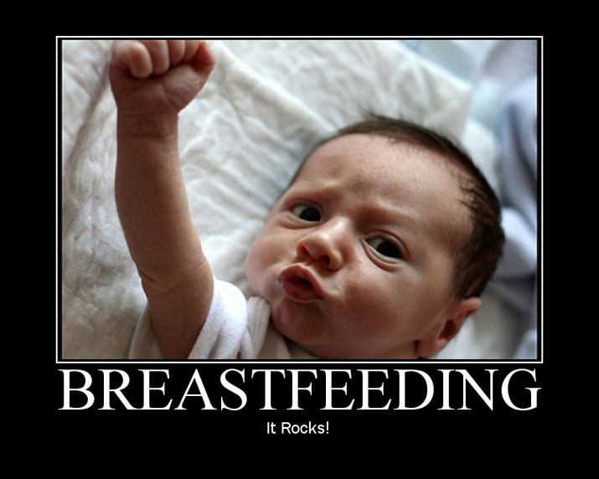
Adopt a lactation accommodation policy!
Providing a breastfeeding-friendly workplace doesn’t only make sense for babies and moms, it also makes business sense.

Slide 16


Questions?
For more information or assistance, please contact:
(INSERT HUMAN RESOURCE OR LACTATION PROGRAM
CONTACT INFORMATION)

Slide 17

Request More Information or Share Your Success Stories
Contact UC San Diego’s Lactation Supportive Environments Team
LWLactation@ucsd.edu
www.HealthyWorks.org
www.breastfeeding.org
We’re here to help!

